Slide 1


Wireless and Mobile Networks

Slide 2
Goals of Today’s Lecture
Wireless links: unique channel characteristics
  High, time-varying bit-error rate
  Broadcast where some nodes can’t hear each other
Mobile hosts: addressing and routing challenges
  Keeping track of the host’s changing attachment point
  Maintaining a data transfer as the host moves
Two specific technologies
  Wireless: 802.11 wireless LAN (aka “WiFi”)
  Mobility: Mobile IP
Notes:
Wireless communications use the air as the communication medium
Signals travel through the airs

Slide 3
Wireless Links and Networks

Slide 4
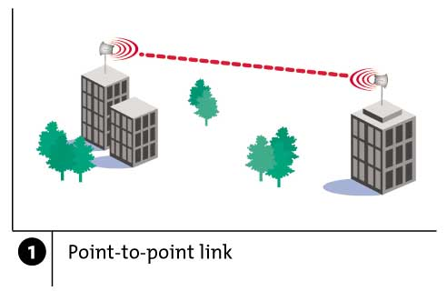
Wireless Links: High Bit Error Rate
Decreasing signal strength
  Disperses as it travels greater distance
  Attenuates as it passes through matter
Notes:
As the signals travel farther, its strength decreases
Disperse – the signal becomes weaker, especially when passing through matter such as walls
Attenuates – the signal becomes weaker

Slide 5
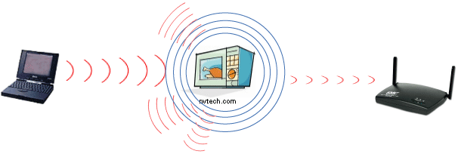
Wireless Links: High Bit Error Rate
Interference from other sources
  Radio sources in same frequency band
  E.g., 2.4 GHz wireless phone interferes with 802.11b wireless LAN
  Electromagnetic noise (e.g., microwave oven)
Notes:
Zoom call giving important presentation, but your neighbour decides to mow the lawn right outside your window, the roaring sound drowns you out
While you are trying to stream your favourite show, the microwave decides it needs more bandwidth for your pop corn, causing your internet to be slow

Slide 6
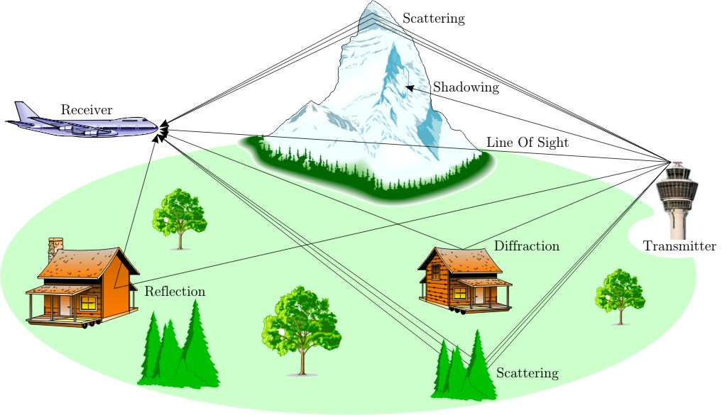
Wireless Links: High Bit Error Rate
Multi-path propagation
  Electromagnetic waves reflect off objects
  Taking many paths of different lengths
  Causing blurring of signal at the receiver
receiver
transmitter

Slide 7
Dealing With Bit Errors
Wireless vs. wired links
  Wired: most loss is due to congestion
  Wireless: higher, time-varying bit-error rate
Dealing with high bit-error rates
  Sender could increase transmission power
    Requires more energy (bad for battery-powered hosts)
    Creates more interference with other senders
  Stronger error detection and recovery
    More powerful error detection codes
    Link-layer retransmission of corrupted frames
Notes:
Requires more energy ( smartphone, laptop)
When a device sends a stronger signal, it can interfere with other nearby devices trying to transmit wifi routers or wireless gadgets can cause signal noise
Real-life example:
Imagine a teacher sends a student a message:
“Submit the assignment on Monday.”
The student receives:
“Submit the assignment on M_nday.”

Slide 8
Wireless Links: Broadcast Limitations
Wired broadcast links
  E.g., Ethernet bridging, in wired LANs
  All nodes receive transmissions from all other nodes
Wireless broadcast: hidden terminal problem
C
A and B hear each other
B and C hear each other
But, A and C do not
So, A and C are unaware
of their interference at B.
B
A
Notes:
Ethernet LAN – if computer A sends a message, all other computers on the network receive that message, but only the intended recipient processes it. Others discard it

Slide 9
Wireless Links: Broadcast Limitations
Wired broadcast links
  E.g., Ethernet bridging, in wired LANs
  All nodes receive transmissions from all other nodes
Wireless broadcast: fading over distance
A
B
C
A and B hear each other
B and C hear each other
But, A and C do not
So, A and C are unaware
of their interference at B.
A’s signal
strength
C’s signal
strength
space

Slide 10
Example Wireless Link Technologies
Data networks
  Indoor (10-30 meters)
    802.11n: 200 Mbps,802.11a and g: 54 Mbps,802.11b: 5-11 Mbps
    802.15.1: 1 Mbps
  Outdoor (50 meters to 20 k meters)
    802.11 and g point-to-point: 54 Mbps
    WiMax: 5-11 Mbps
Cellular networks, outdoors
  3G enhanced: 4 Mbps now we have 4G (4G 15-20, 4G LITE-ADVANCED (50-80), 4G LITE ADVANCED-PRO (60-100) and 5G (100-300)
  3G: 384 Kbps
  2G: 56 Kbps

Slide 11
Wireless Network: Wireless Link
Wireless link
Typically used to connect mobile(s) to base station
Also used as backbone link
Multiple access protocol coordinates link access
network
infrastructure
Notes:
High capacity communication link forms pathway for data traffic with a network
Connects various part of the networks
Base station, routers, switches to ensure data is transferred across the network
Is set of rules that determine how multiple devices share the same communication channel TDMA, FDMA, CDMA

Slide 12
Wireless Network: Wireless Hosts
Wireless host
Laptop, PDA, IP phone
Run applications
May be stationary (non-mobile) or mobile
network
infrastructure
Notes:
Personal digital assistant

Slide 13
Wireless Network: Base Station
Base station
Typically connected to wired network
Relay responsible for sending packets between wired network and wireless host(s) in its “area”
E.g., cell towers, 802.11 access points
network
infrastructure
Notes:
Base station is connected to a core network via ethernet cable or other (ensures high speed and reliable transmissions)
Phones connect to the base stations wireless

Slide 14
Wireless Network: Infrastructure
Network infrastructure
Larger network with which a wireless host wants to communicate
Typically a wired network
Provides traditional network services
May not always exist
network
infrastructure
Notes:
📱 Phone │ │ Wireless ↓ 📡 Base Station │ │ Wired network ↓ 🌐 Network Infrastructure │ ↓ 🌍 Internet │ ↓ 🖥️ Google Server
Device → Base station → Network infrastructure
But in an ad hoc network:
Device ↔ Device ↔ Device
There may be no base station or larger wired infrastructure.

Slide 15
Scenario #1: Infrastructure Mode
Infrastructure mode
Base station connects mobiles into wired network
Network provides services (addressing, routing, DNS)
Handoff: mobile changes base station providing connection to wired network
network
infrastructure
Notes:
Device moving away from its coverage of its base stations, the signal strength weakens
The network detects this and initiate the handoff process to maintain strong connection

Slide 16
Scenario #2: Ad Hoc Networks
Ad hoc mode
No base stations
Nodes can only transmit to other nodes within link coverage
Nodes self-organise and route among themselves
Notes:
Emergency situations – emergency response quick & reliable communication
Easy sharing of files & resources without needing server
Decentralised control – each device is independent node, managing its own connections & data routing
A sends the data to B.
B receives it and forwards it to C.
C receives the data.

Slide 17
Infrastructure vs. Ad Hoc
Infrastructure mode
  Wireless hosts are associated with a base station
  Traditional services provided by the connected network
  E.g., address assignment, routing, and DNS resolution
Ad hoc networks
  Wireless hosts have no infrastructure to connect to
  Hosts themselves must provide network services
Similar in spirit to the difference between
  Client-server communication
  Peer-to-peer communication

Slide 18
Different Types of Wireless Networks
 | Infrastructure-based | Infrastructure-less
Single hop | Base station connected to larger wired network (e.g., WiFi wireless LAN, and cellular telephony networks) | No wired network; one node coordinates the transmissions of the others (e.g., Bluetooth, and ad hoc 802.11)
Multi-hop | Base station exists, but some nodes must relay through other nodes (e.g., wireless sensor networks, and wireless mesh networks | No base station exists, and some nodes must relay through others (e.g., mobile ad hoc networks, like vehicular ad hoc networks)

Slide 19
WiFi: 802.11 Wireless LANs

Slide 20
802.11 LAN Architecture
Access Point (AP)
  Base station that communicates with the wireless hosts
Basic Service Set (BSS)
  Coverage of one AP
  AP acts as the master
  Identified by an “network name” known as an SSID
Internet
hub, switch
or router
AP
BSS 1
AP
BSS 2
SSID: Service Set Identifier
Notes:
An Access Point is the device that provides the wireless connection between wireless hosts and the network.
A BSS is basically the coverage area served by one access point.
The SSID is the name we see when we search for available Wi-Fi networks.
Available Wi-Fi:📶 Home_WiFi📶 UL_Campus📶 Student_WiFi

Slide 21
See you on Friday

Slide 22
Channels and Association
Multiple channels at different frequencies
  Network administrator chooses frequency for AP
  Interference if channel is same as neighboring AP
Access points send periodic beacon frames
  Containing AP’s name (SSID) and MAC address
  Host scans channels, listening for beacon frames
  Host selects an access point to associate with
Beacon frames from APs
Associate request from host
Association response from AP
Notes:
In a Wi-Fi network, there can be multiple Access Points (APs) operating in the same general area.
Each AP can operate on a particular radio channel/frequency. (AP 1 – channel 1, AP 2 – channel 2 .. This reduce interference
Beacon frame a special management message, tells nearby devices I am an AP, this is my network name and this is my address
Real-life example
Suppose you open Wi-Fi on your phone and see:
📶 UL_WiFi
📶 Student_WiFi
📶 Home_WiFi
Your phone is essentially scanning the available channels and listening for beacon frames.
Once you select Student_WiFi, your phone sends an association request to the appropriate AP.

Slide 23
Mobility Within the Same Subnet
H1 remains in same IP subnet
  IP address of the host can remain same
  Ongoing data transfers can continue uninterrupted
H1 recognizes the need to change
  H1 detects a weakening signal
  Starts scanning for stronger one
Changes APs with same SSID
  H1 disassociates from one
  And associates with other
Switch learns new location
  Self-learning mechanism
router
hub or
switch
BBS 1
AP 1
AP 2
H1
BBS 2
Notes:
a device can move between Access Points without necessarily changing its IP address.
AP 1 → AP 2
A student walks from one side of the university building to another while using Wi-Fi.
Initially:
Phone → AP 1
As the student moves away from AP 1:
Signal strength decreases.
The phone detects that another AP provides a stronger connection:
Phone → AP 2
Why doesn't the IP address need to change?
Because both APs may belong to the same IP subnet.

Slide 24
CSMA: Carrier Sense, Multiple Access
Multiple access: channel is shared medium
  Station: wireless host or access point
  Multiple stations may want to transmit at same time
Carrier sense: sense channel before sending
  Station doesn’t send when channel is busy
  To prevent collisions with ongoing transfers
  But, detecting ongoing transfers isn’t always possible
A
B
C
C
A’s signal
strength
C’s signal
strength
B
A
space
Notes:
That means many devices are competing for the same communication channel. A,B,AND C all want to transmit over the same channel problem is when they do there will be a collision.
Before transmitting, a wireless station first listens to the channel

Slide 25
CA: Collision Avoidance, Not Detection
Collision detection in wired Ethernet
  Station listens while transmitting
  Detects collision with other transmission
  Aborts transmission and tries sending again
Problem #1: cannot detect all collisions
  Hidden terminal problem
  Fading
Problem #2: listening while sending
  Strength of received signal is much smaller
  Expensive to build hardware that detects collisions
So, 802.11 does not do collision detection

Slide 26
Medium Access Control in 802.11
Collision avoidance, not detection
  Once a station starts transmitting, send in its entirety
  More aggressive collision-avoidance techniques
  E.g., waiting a little after sensing an idle channel
  To reduce likelihood two stations transmit at once
Link-layer acknowledgment and retransmission
  CRC to detect errors
  Receiving station sends an acknowledgment
  Sending station retransmits if no ACK is received
  Giving up after a few failed transmissions
Notes:
In driving – advance driver assistant – has sensors, and cameras to detect collisions
Defensive driving – maintaining safe following distance
In networking – use csma /ca
CRC – cyclic redundancy check sender calculates a CRC value based on the data and appends

Slide 27
Host Mobility
Notes:
Refers to the ability of a device to change its point of attachment to a network while maintaining ongoing communication without interruption.
For example:
A laptop connects to Wi-Fi in one building.
Then the user moves to another building.
The laptop connects through another access point/network.
The challenge is:
How can the network continue delivering packets to the moving device?
This question leads us into Mobile IP.

Slide 28
Varying Degrees of User Mobility
Moves only within same access network
  Single access point: mobility is irrelevant
  Multiple access points: only link layer changes
  Either way, users is not mobile at the network layer
Shuts down between changes access networks
  Host gets new IP address at the new access network
  No need to support any ongoing transfers
  Applications have become good at supporting this
Maintains connections while changing networks
  Surfing the ‘net while driving in a car
  Need to ensure traffic continues to reach the host
Notes:
The user moves between access points, but remains within the same network; there is no major change at the network layer. The change takes place at the link layer
Example:
You close your laptop at work, go home, connect to your home Wi-Fi, and start browsing again.
The user changes networks but wants the existing communication to continue.
For example:
Wi-Fi network A → Wi-Fi network B
while still:
watching a video,
downloading a file,
having a voice call, or
maintaining a network session.
The network must somehow ensure that packets continue reaching the mobile host.

Slide 29
Maintaining Ongoing Transfers
Seamless transmission to a mobile host
A
B
Notes:
Computer A → Internet → Mobile Host B
Now B moves to another network.
The problem is that A is still sending packets toward B's old location.
So we need a mechanism that allows:
A's packets to continue reaching B even though B has moved.
This is the central problem that Mobile IP attempts to solve.

Slide 30

E.g., Keeping Track of Mobile Friends
Sending a letter to a friend who moves often
  How do you know where to reach him?
Option #1: have him update you
  Friend contacts you on each move
  So you can mail him directly
Option #2: ask his parents when needed
  Parents serve as “permanent address”
  They can forward your letter to him
  Or, they can update you

Slide 31
Letting Routing Protocol Handle It
Mobile node has a single, persistent address
Address injected into routing protocol (e.g., OSPF)
A
B
12.34.45.0/24
12.34.45.7/32
Mobile host with IP address 12.34.45.7

Slide 32
Summary: Letting Routing Handle It
Advantages
  No changes to the end host
  Traffic follows an efficient path to new location
Disadvantages
  Does not scale to large number of mobile hosts
    Large number of routing-protocol messages
    Larger routing tables to store smaller address blocks
Alternative
  Mobile IP
Notes:
Device don’t have to change settings when moving between networks
Traffic is routed efficiently to the devices new location, ensuring optimal performance and min delay
it may struggle to handle many devices moving between networks
Routing overhead – increases traffic might require processing requirements
Consume memory & processing power

Slide 33
Home Network and Home Agent
Home network: permanent “home” of mobile
(e.g., 128.119.40/24)
Home agent: entity that will perform mobility functions on behalf of mobile, when mobile is remote
wide area network
Permanent address: address in home network, can always be used to reach mobile
e.g., 128.119.40.186
correspondent
Correspondent: wants to communicate with mobile

Slide 34
Visited Network and Care-of Address
Visited network: network in which mobile currently resides (e.g., 79.129.13/24)
Permanent address: remains constant (e.g., 128.119.40.186)
Care-of-address: address in visited network.
(e.g., 79,129.13.2)
wide area network
Home agent: entity in visited network that performs mobility functions on behalf of mobile.
Correspondent: wants to communicate with mobile

Slide 35
Mobility: Registration
visited network
home network
1
2
wide area network
mobile contacts foreign agent on entering visited network
foreign agent contacts home agent home: “this mobile is resident in my network”
Foreign agent knows about mobile
Home agent knows location of mobile

Slide 36
Mobility via Indirect Routing
foreign agent receives packets, forwards to mobile
home agent intercepts packets, forwards to foreign agent
visited
network
home
network
3
wide area network
2
1
correspondent addresses packets using home address of mobile
4
mobile replies directly to correspondent

Slide 37
Indirect Routing: Efficiency Issues
Mobile uses two addresses
  Permanent address: used by correspondent (making mobile’s location is transparent to correspondent)
  Care-of-address: used by the home agent to forward datagrams to the mobile
Mobile may perform the foreign agent functions
Triangle routing is inefficient
  E.g., correspondent and mobile in the same network

Slide 38
Mobility via Direct Routing
foreign agent receives packets, forwards to mobile
correspondent forwards to foreign agent
visited
network
home
network
4
wide area network
2
3
correspondent requests, receives foreign address of mobile
1
4
mobile replies directly to correspondent
No longer transparent to the correspondent

Slide 39
Impact on Higher-Layer Protocols
Wireless and mobility change path properties
  Wireless: higher packet loss, not from congestion
  Mobility: transient disruptions, and changes in RTT
Logically, impact should be minimal …
  Best-effort service model remains unchanged
  TCP and UDP can (and do) run over wireless, mobile
But, performance definitely is affected
  TCP treats packet loss as a sign of congestion
  TCP tries to estimate the RTT to drive retransmissions
  TCP does not perform well under out-of-order packets
Internet not designed with these issues in mind
Notes:
Signal interference, physical distractions
Brief interruptions and experience changes in round trip time
A network service that does not provide any guarantees on delivery
RTT – round-trip time

Slide 40

Computer Network Security

Slide 41
Security Requirements
Confidentiality
Integrity
Availability
Notes:
Refers to the ability of being honest and having strong moral principles ( someone to be trusted to do the right thing even when no one is watching).

Slide 42
Passive Attacks
Eavesdropping on transmissions
To obtain information
Release of message contents
  Outsider learns content of transmission
Traffic analysis
  By monitoring frequency and length of messages, even encrypted, nature of communication may be guessed
Difficult to detect
Can be prevented (encryption, secure protocols, network monitoring)
Notes:
Gains access to the actual content of the messages being transmitted, could lead to data breach or security issues
Seeing how often messages are sent and their size can reveal valuable information about the nature of the communication.
Do not alter data or communication process

Slide 43
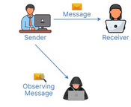
Passive attack

Slide 44
Active Attacks
Masquerade
  Pretending to be a different entity
Replay -
Modification of messages
Denial of Service
Easy to detect
  Extremely high traffic vol, abnormal connection rates, sudden increase in CPU usage , large number of requests from suspicious sources
Hard to prevent
Notes:
Deliberate attempts to alter, disrupt, or manipulate a network system
Stolen credentials
Masquerade – attacker pretends to be authorised user
Replay – attacker intercepts and retransmit message (duplicate paymet)
Attackers alters content, delay it and reorders it to produce unauthorised effect (compromises integrity)
Attacker overwhelms network / system with excessive traffic, rendering it unavailable to legitimate users

Slide 45
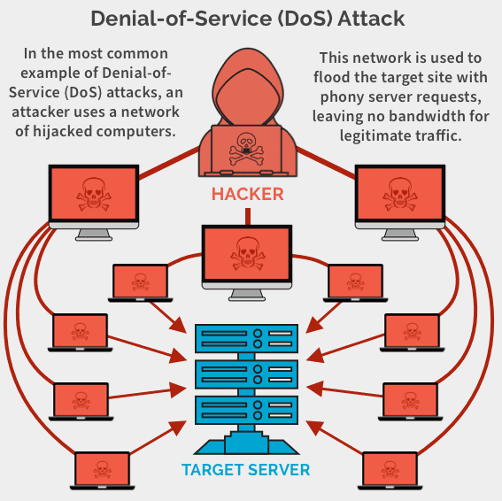
Denial of Service (DoS)

Slide 46
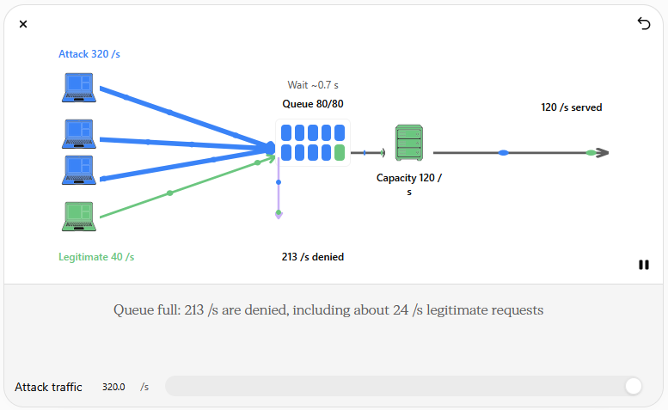
DoS

Slide 47
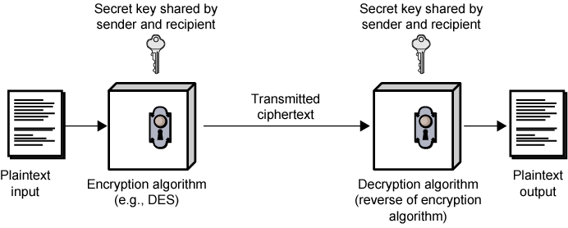
Symmetric Encryption
Notes:
Uses same key – both users agree on a secret key
Sender starts with original messages known as plaintext.
Sender uses the shared key to transform the plaintext into ciphertext, ( scrambles data, unreadable to anyone)

Slide 48
Ingredients
Plain text
Encryption algorithm
Secret key
Cipher text
Decryption algorithm

Slide 49
Requirements for Security
Strong encryption algorithm
  Even if known, should not be able to decrypt or work out key
  Even if a number of cipher texts are available together with plain texts of them
Sender and receiver must obtain secret key securely
Once key is known, all communication using this key is readable
Notes:
Should be robust enough
Even if an attacker has access to several ciphertexts and their corresponding plaintexts, they should not work out the encryption key
If the key exchange process is compromised, the security of the entire communication is at risk

Slide 50
Attacking Encryption
Crypt analysis
  Relay on nature of algorithm plus some knowledge of general characteristics of plain text
  Attempt to deduce plain text or key
Brute force
  Try every possible key until plaintext is achieved
  Scenario attacker targets a website login page
  Password – if the password consists of 4 characters
  Each character can be a letter (26 ch) there would be 26^4 possible combinations
  Attacker writes a program that tries every combination
  If website don’t have limits for trying
Notes:
Two fundamental methods to break encryption
Brute force – cracking passwords
Attacker attempts all possible combinations of characteristics to crack a password

Slide 51
Public key cryptography
Fundamental component of public key infrastructure (PKI).
Enables secure data exchange
  Authentication
  Integrity verification
  Making it essential for businesses looking to protect their data from malicious attacks.

Slide 52
What is it?
Public key cryptography known as asymmetric cryptography
Uses a pair of keys for encryption & decryption
Public key & private key
The public key is openly shared, and encrypts the data
The private key, kept secret by the owner, decrypts the data

Slide 53
How does public key work?
There are five key steps in the process of sending & receiving data with public key cryptography.
Key generation – a pair of keys is created using a cryptography algorithm. You generate two keys, public key & private key
You and the recipient exchange public keys to establish a secure communication channel.
When someone wants to send you a secure message, they will use your public key to encrypt the data.

Slide 54
Continuation
The encrypted message , now in the form of ciphertext, is then sent to you over standard communication channels like email or secure messaging apps
Decryption
Once you receive the encrypted message, you will use your private key to decrypt it. The private key reverses the encryption process,
Transforming the ciphertext back into its original readable format

Slide 55
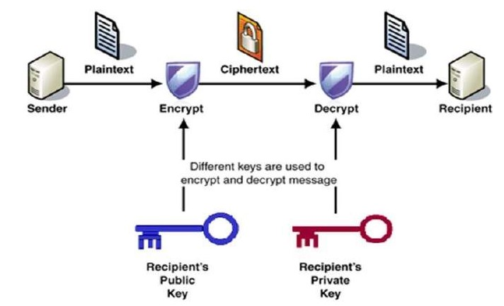
PUBLIC KEY ENCRYPTION

Slide 56
WHO IS VULNERABLE?
Financial institutions and banks
Internet service providers
Pharmaceutical companies
Government & defense agencies
Contractors to various government agencies
Multinational corporations
ANYONE ON THE NETWORK

Slide 57
Common security attacks
Finding a way into the network
  Firewalls
Exploiting software bugs, buffer overflows
  Intrusion Detection Systems
Denial of service
  Ingress filtering, IDS
TCP hijacking
  IPSec
Packet sniffing
  Encryption (SSH,SSL,HTTPS)
Social problems
  Education

Slide 58
Firewalls
Basic problem – many network applications and protocols have security problems that are fixed over time
Is a computer network security system that restricts internet traffic in to, out of, or within a private network
Can be viewed as gated borders or gateways that manage the travel of permitted and prohibited web activity in a private network

Slide 59
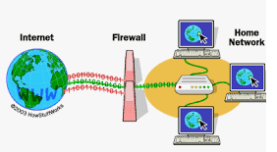
Firewalls
Decides which traffic is allowed to pass through
Which traffic is deemed dangerous

Slide 60
Intrusion detection system
Device or software application that monitors a network for malicious activity or policy violations.
Signatured-based detection
  Analyses network packets for attack signatures
  Unique characteristics or behaviours that are associated with a specific threat
  Maintains a database of attack signatures against which it compares network packets
Anomaly-based detection
  Uses machine learning to create- and continually refine. A baseline model of normal network activity
  Compares network activity to the model and flags deviations

Slide 61

Denial of service
Purpose: make a network service unusable, usually by overloading the server or network
Many different kinds of DoS attacks
  SYN flooding
  SMURF
  Distributed attacks

Slide 62
SMURF
Source IP address of a broadcast ping is forged
Large number of machines respond back to victim, overloading it

Slide 63
TCP Attacks

